Slide 1
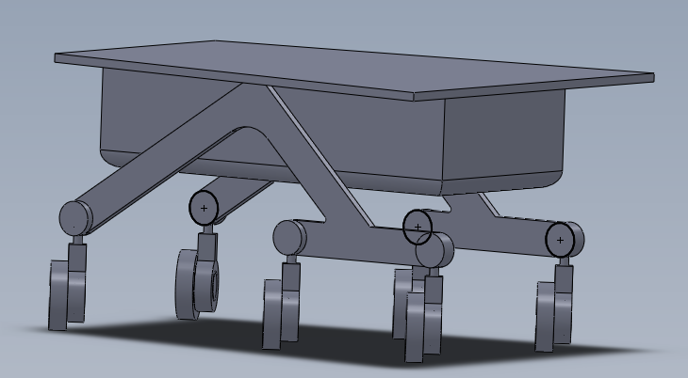
Solar Panel
Body (Houses avonics)
Roller Bearing for pivoting joints

